Slide 1
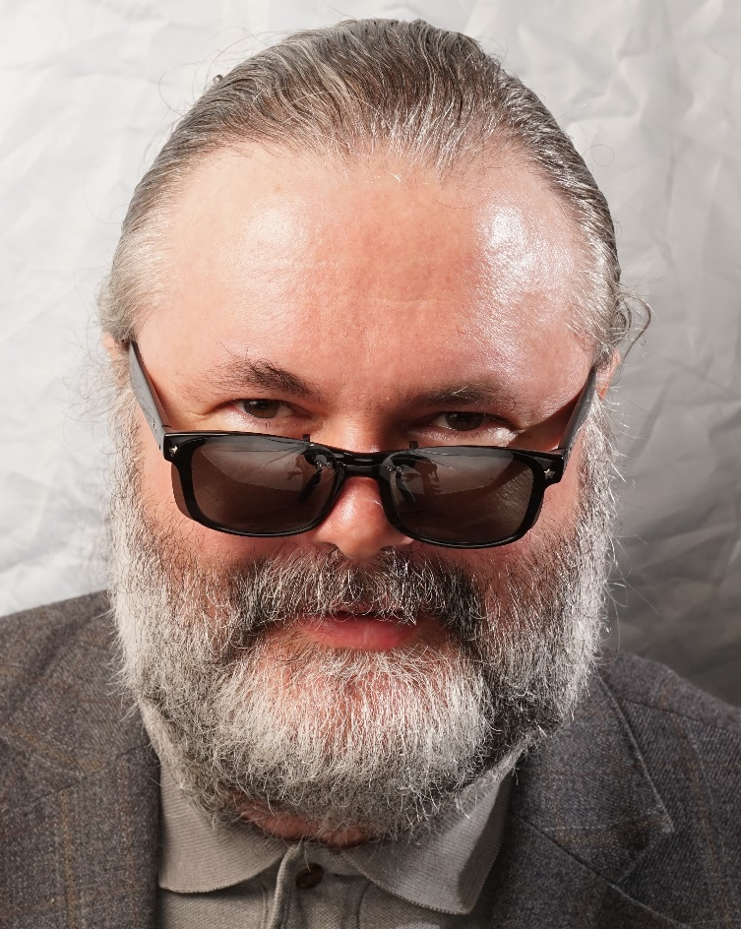
Tracing heirs through Ukrainian archives:
Detective stories of metrical records and censuses
Kirill Chashchin CFE,
APG member

Slide 2
Introduction
The key to success in working with Ukrainian (or, generally, any other archive) is to ask right person the right question.
Be prepared.
Be polite and professional.
What happens if you are wrong?
Tracing the complicated WWII fugitive. Very poor documentation. We resorted to visit the local draft office (военкомат) trying to see if they have a record which might have a home address. Were shown the letter from competitors about the same person. Letter asked “did you drafted him? Please provide document copies” “did you paid his relatives the pension? Please provide document copies”.
It is a common knowledge that военкомат does not deal with pensions, it is the business of собес, while woenkomat only provides the basic document.
The question officer in charge asked me “How I can go to my boss to sign the answer letter when any answer will look stupid?”
We asked the simple question – do you have draft registration cards or the annual alphabet draftees register book? Please check to see what is written under that name. We got the answer the same day. The incorrect inquiry left waiting for another year…

Slide 3
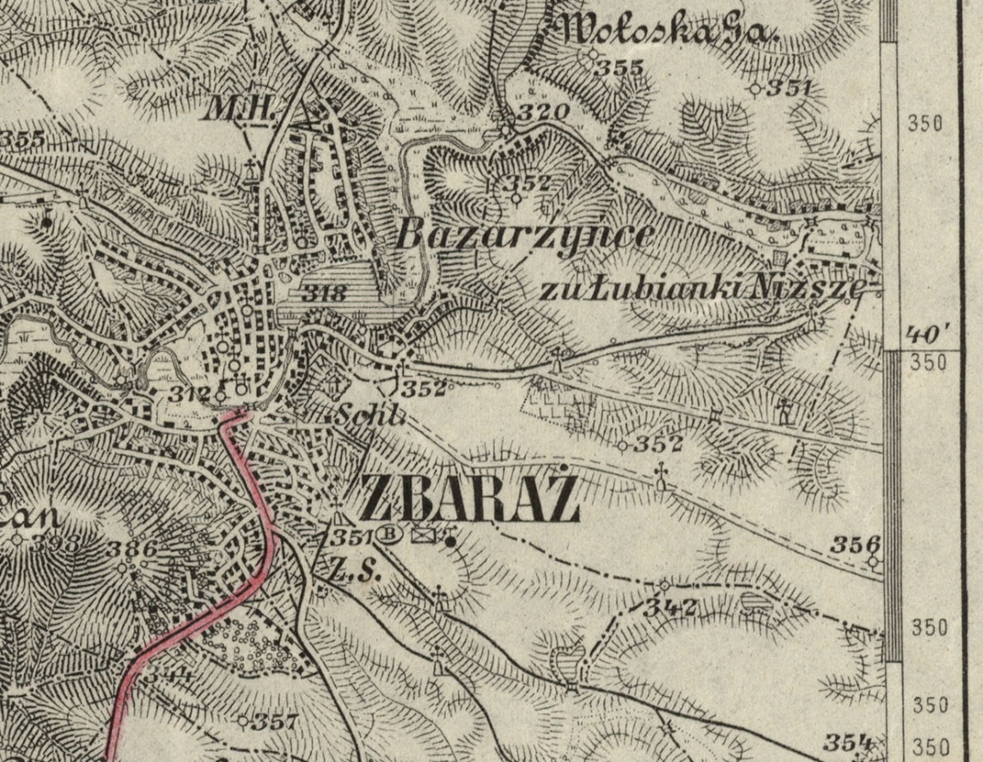
Where to go
1. Forget about borders and countries. You need to pinpoint the exact location.
2. Found a location – determine the administrative-territorial and church division it belonged at different times. Get all the old, new, customary names of the place. You will need all of them.
3. Determine the records availability.

Slide 4
Locations, locations, locations
Słownik geograficzny Królestwa Polskiego i innych krajów słowiańskich (The Geographical Dictionary of the Kingdom of Poland and other Slavic Countries, 15 volumes, published 1880–1902, available online, google Słownik geograficzny );
Jewishgen.org – very good Gazetteer for Jewish and non-jewish Ukraine, has million of spelling variations for the same place (search for a town at the home page) Nizhyn [Ukr], Nezhin [Rus], Nyezhin [Yid], Niezhin [Rus], Nieżyn [Pol], Nischyn [Ger], Nizhin, Neshin;
Topographic maps – Polish, German, Austrian, Russian Empire, Genshtab 1930s, 1953 US Military 1:250000 with old place names, Google/Yandex.
Familysearch.org
Administrative-Territorial USSR 1939-1945 database - Справочник административного деления СССР в 1939-1945 годах (soldat.ru/spravka/locality/sssr/ )
Different places with the same name – wiki has good coverage but OLD DISAPPEARED VILLAGES are missing. Always switch languages – Ukrainian/Russian/Polish/Byelorussian. Content is really different, and you never know where you will find Try and see yourself: ukr: Михайлівка rus: Михайловка pol: Mychajliwka
History of administrative-territorial division for required region. Sometimes in archives, sometimes in wiki, sometimes at book-old.ru
Lists of inhabited places (Списки населенных мест) by guberniyas, frequently with alphabet index at the end, 1860s-1890s.

Slide 5
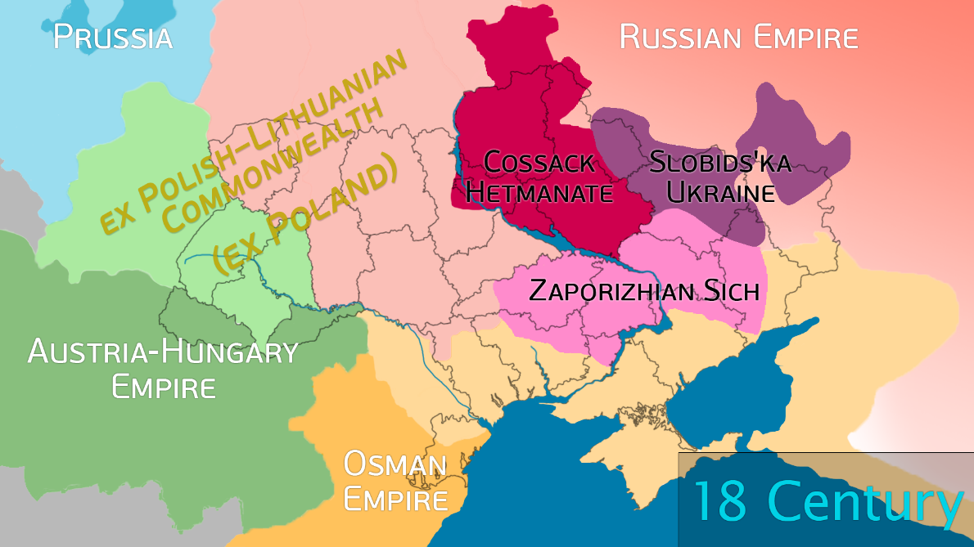

Slide 6
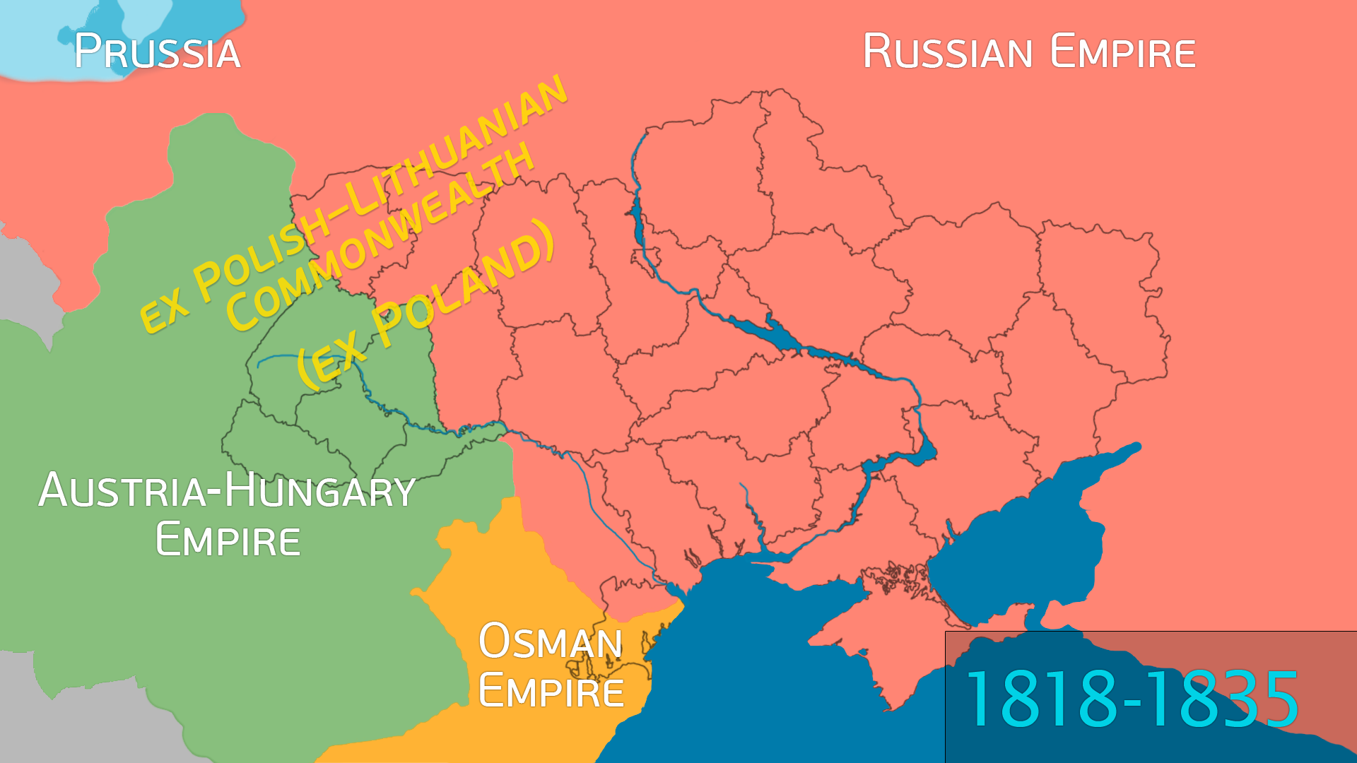

Slide 7
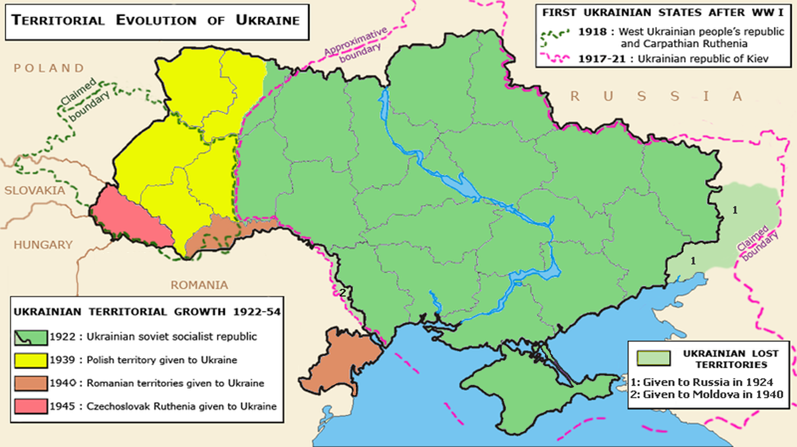

Slide 8
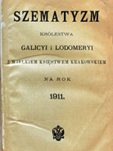
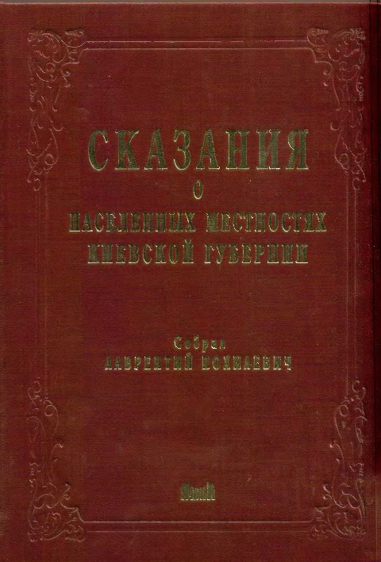
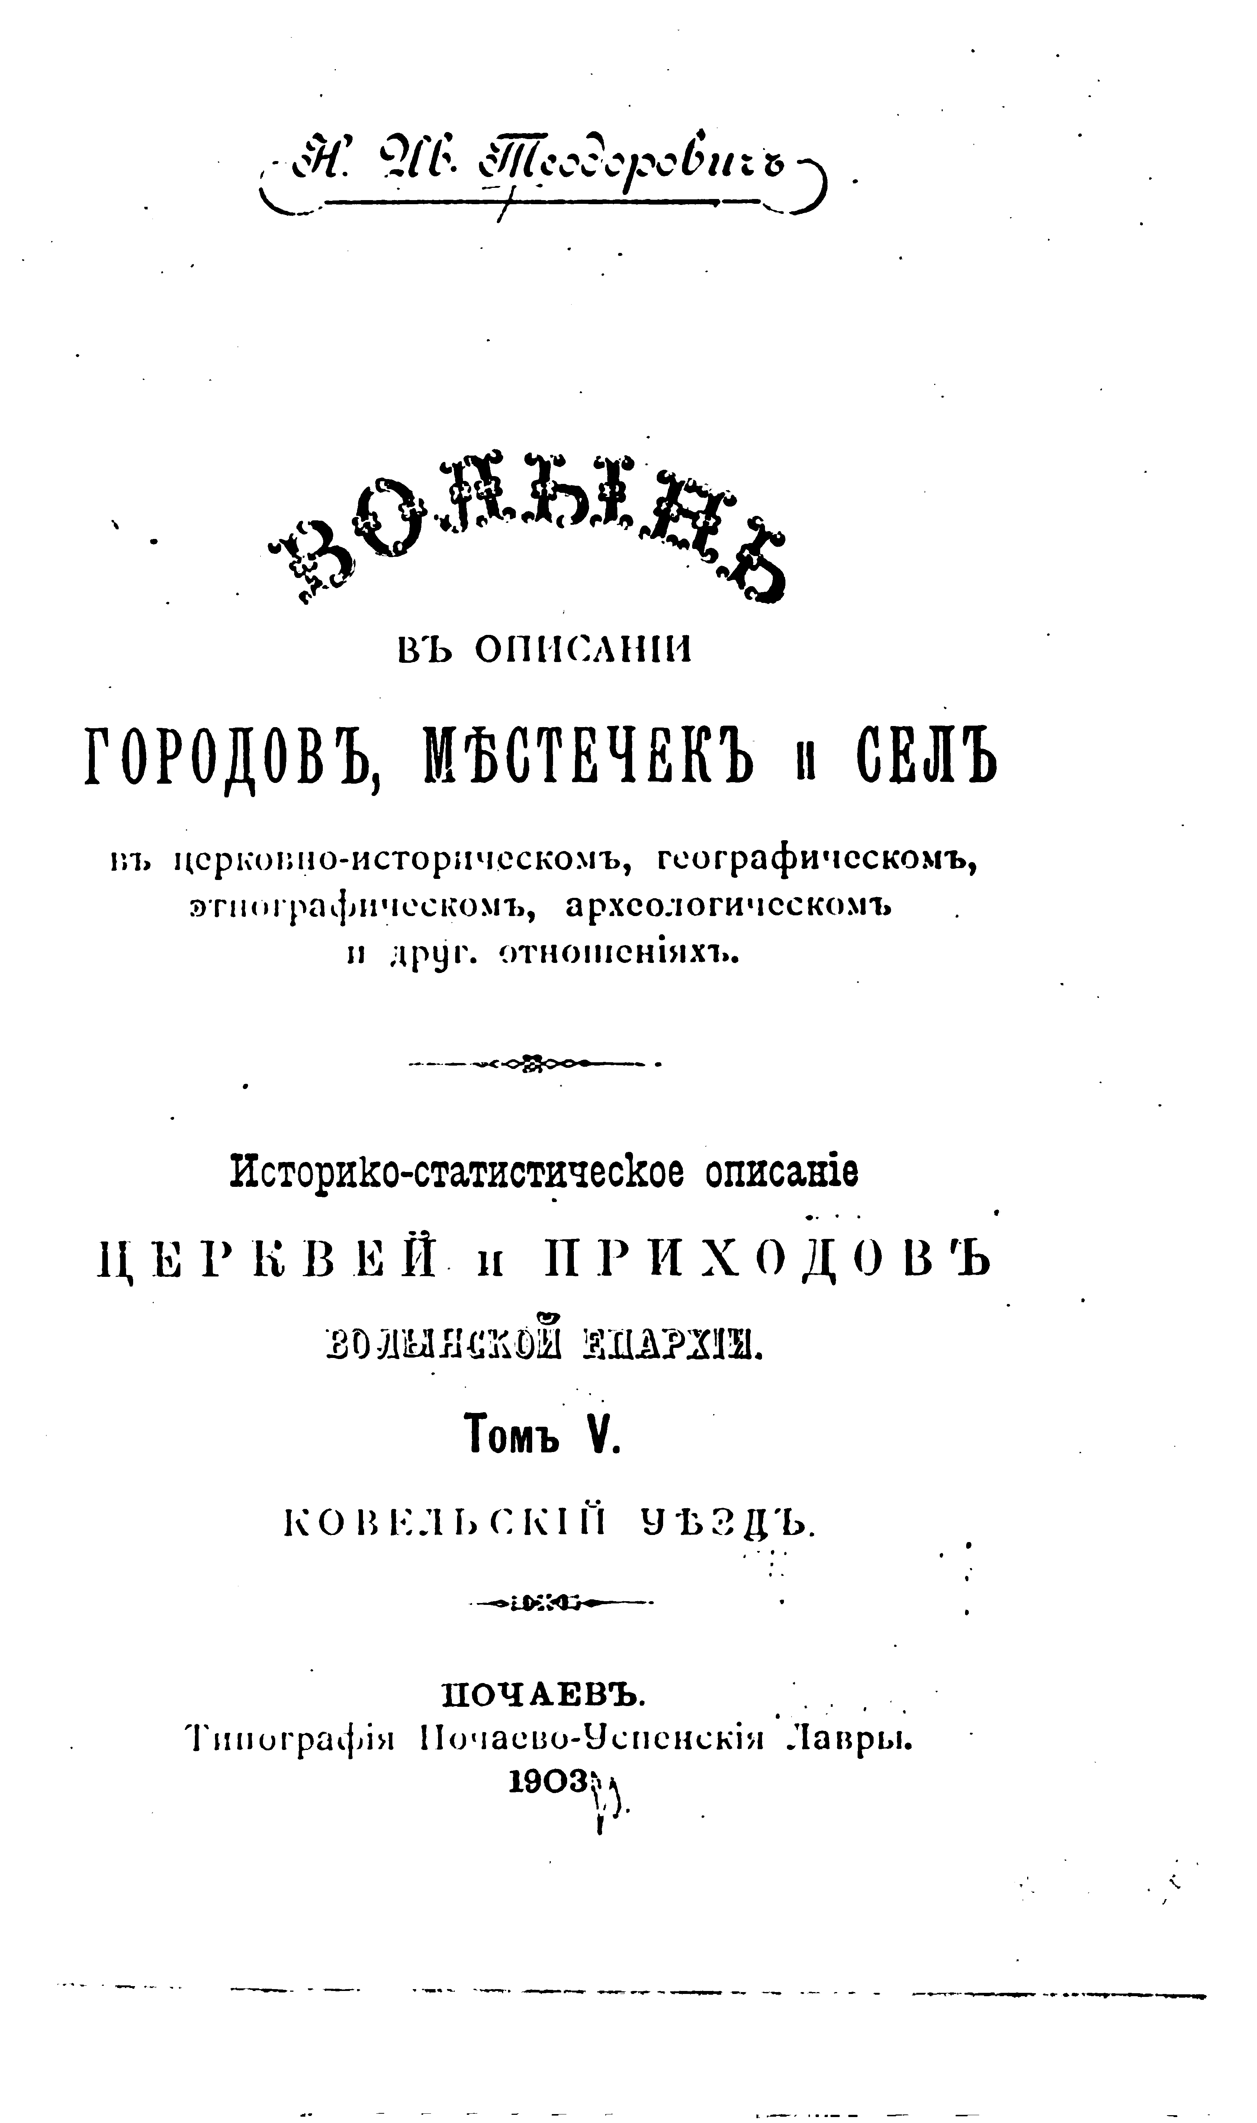
Church Geography
Шематизм (szematyzm) (Galicia, Bukovina);
Епархиальный справочник (list of churches and monasteries for eparkhiya – different names, search by Gubernija names);
book-old.ru;
Pokhilevich (Kiev) / Secinsky (Podolia) / Teodorovich (Volynia) / Gumilevsky (Kharkov);
Educated guess from the topographic maps.

Slide 9
Records availability
Published reference: Міжархівний довідник Зведений Каталог метричних книг, що зберігаються в державних архівах України (2008, Kiev, 8 volumes, searchable PDFs, can be downloaded at our site) – missing 2 large repositories: Kiev and Lviv historical archive; Not updated after the publication date.
Rtr-foundation.org
Call to relevant archive (reading room) or RAGS to ascertain records availability.
1. Волинська губернія
2. Дубенський деканат
3. Церква Святого великомученика Георгія, с. Боремель Боремельської вол. Дубенського пов.
4. –
5. Народження: 1814: ф. 382, оп. 3, спр. 48; 1823: ф. 382, оп. 3, спр. 91; 1827: ф. 382, оп. 3, спр. 116; 1833: ф. 382, оп. 3, спр. 119; 1834: ф. 382, оп. 3, спр. 120
6. Шлюб: 1814: ф. 382, оп. 3, спр. 48; 1823: ф. 382, оп. 3, спр. 91; 1827: ф. 382, оп. 3, спр. 116; 1833: ф. 382, оп. 3, спр. 119; 1834: ф. 382, оп. 3, спр. 120
7. –
8. Смерть: 1814: ф. 382, оп. 3, спр. 48; 1823: ф. 382, оп. 3, спр. 91; 1827: ф. 382, оп. 3, спр. 116; 1833: ф. 382, оп. 3, спр. 119; 1834: ф. 382, оп. 3, спр. 120

Slide 10
Contact archive
Write to the archive directly (write, call to be sure your letter received, call to be sure it is assigned to the archivist to act, send payment, call to make sure they received it…)
Find a local researcher.

Slide 11
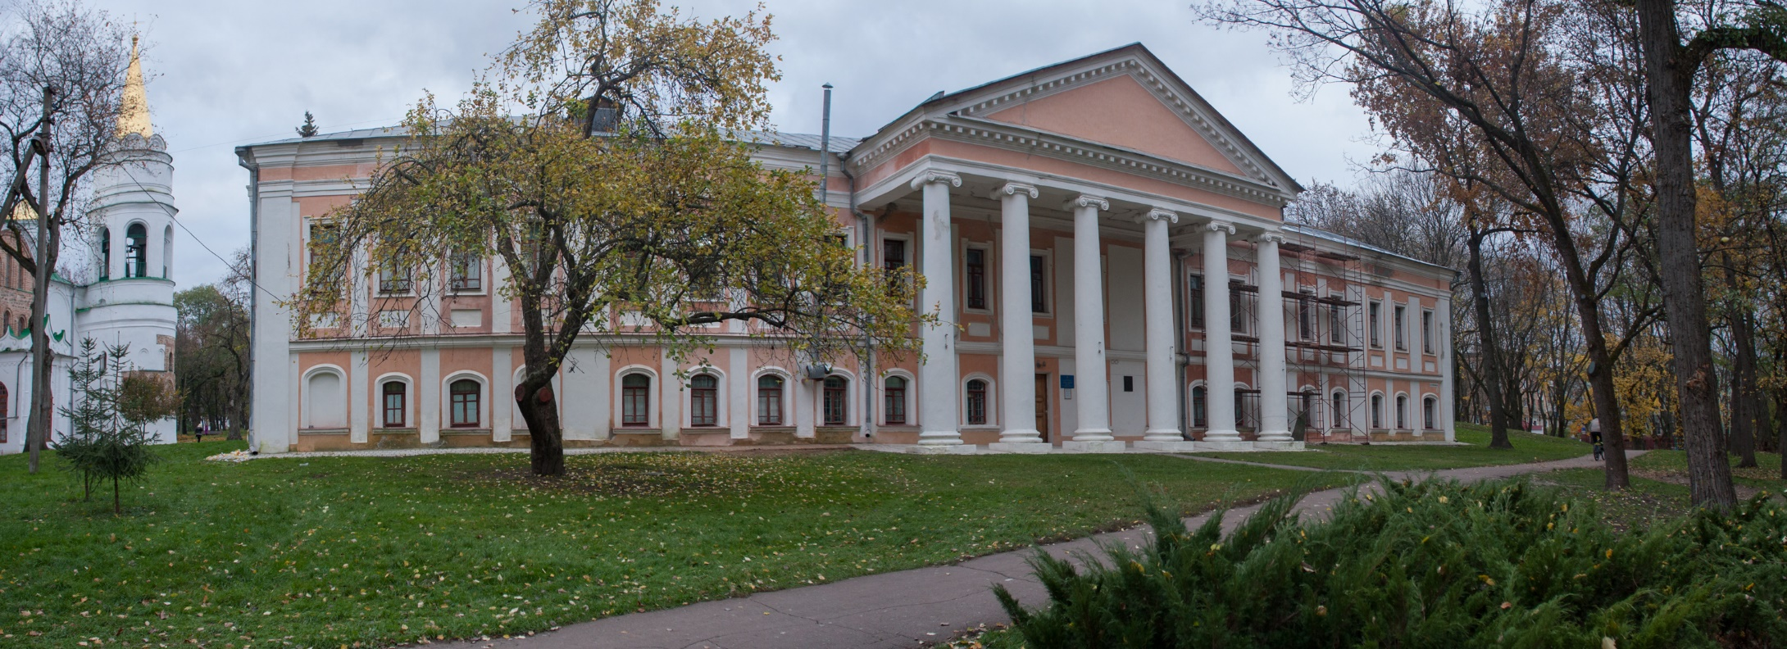
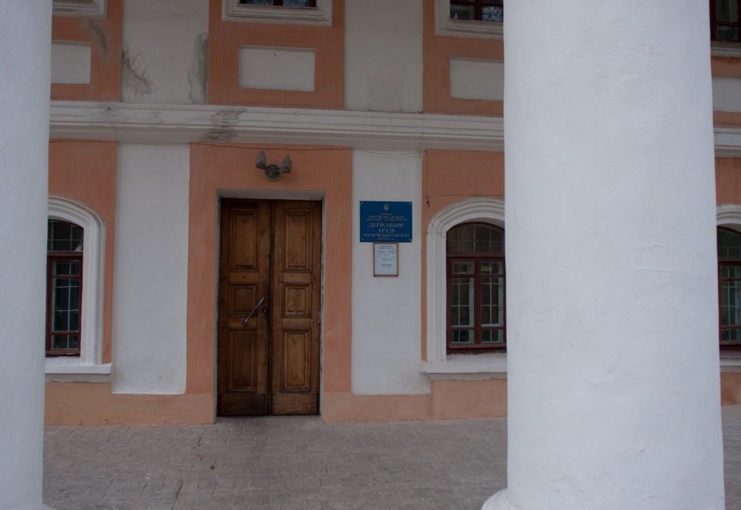
Chernihiv archive

Slide 12
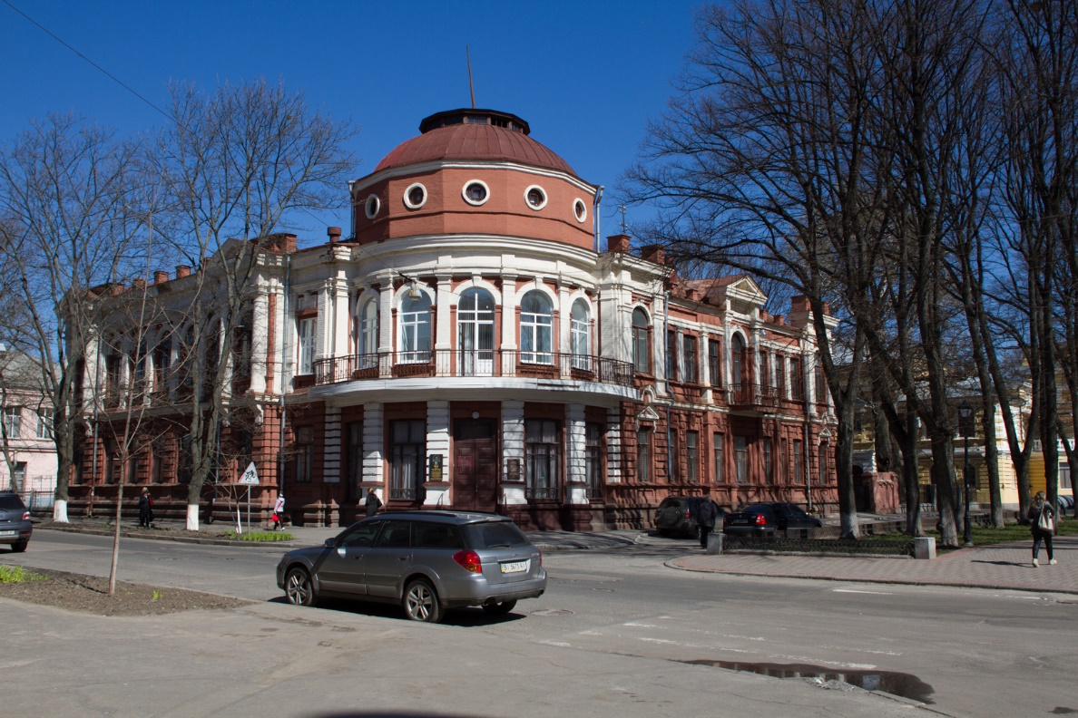
Poltava archive

Slide 13
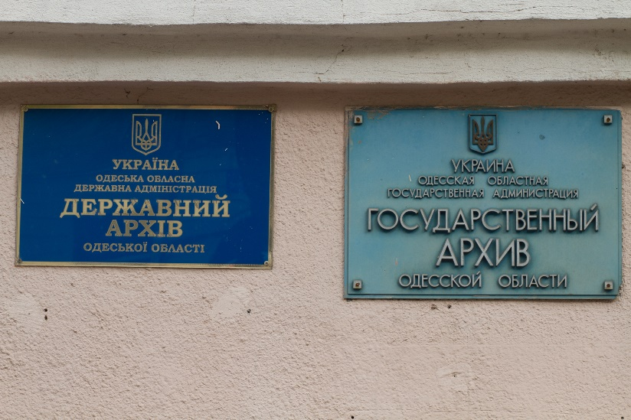
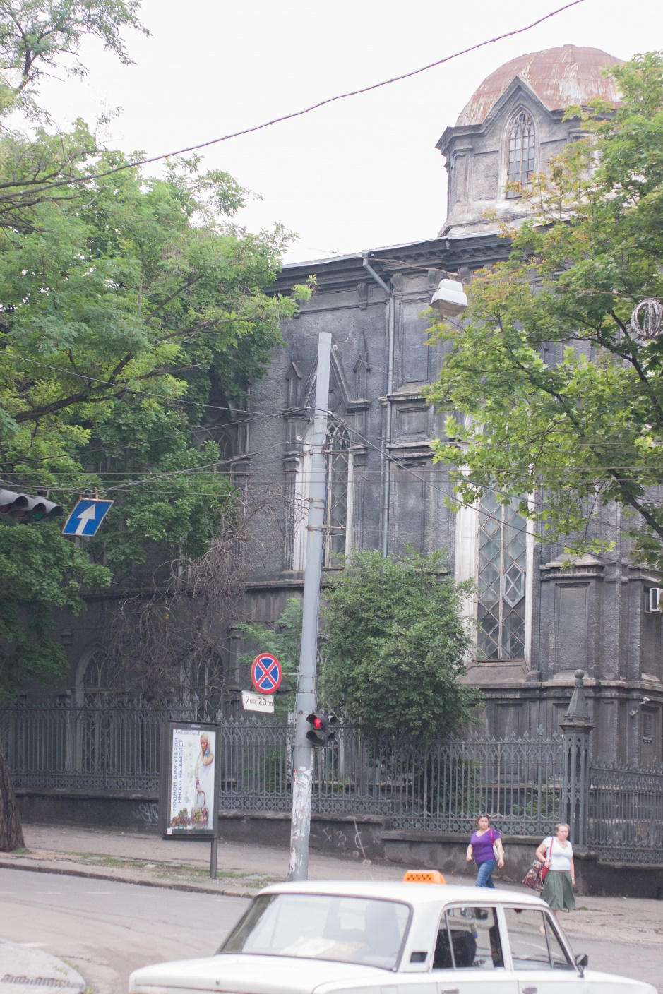
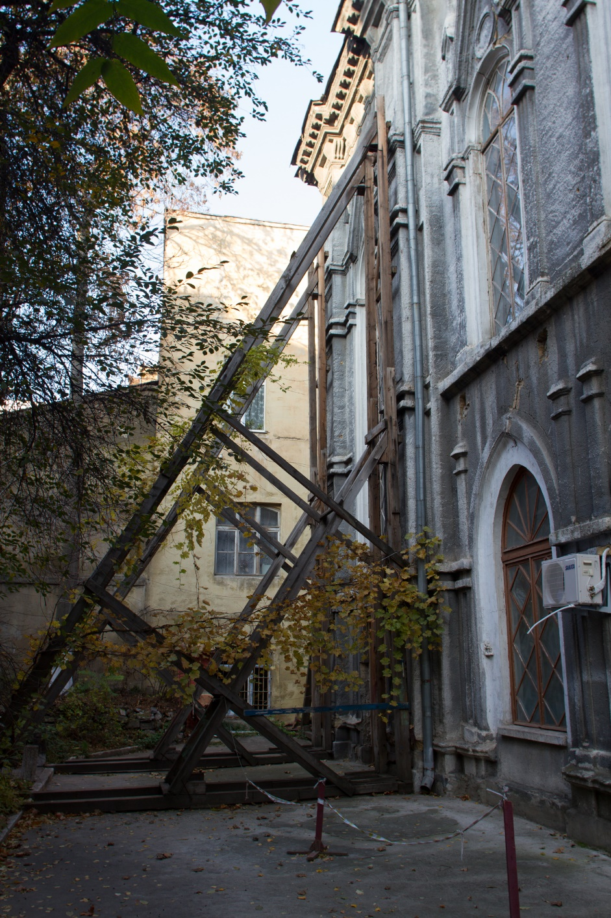
Odessa archive

Slide 14
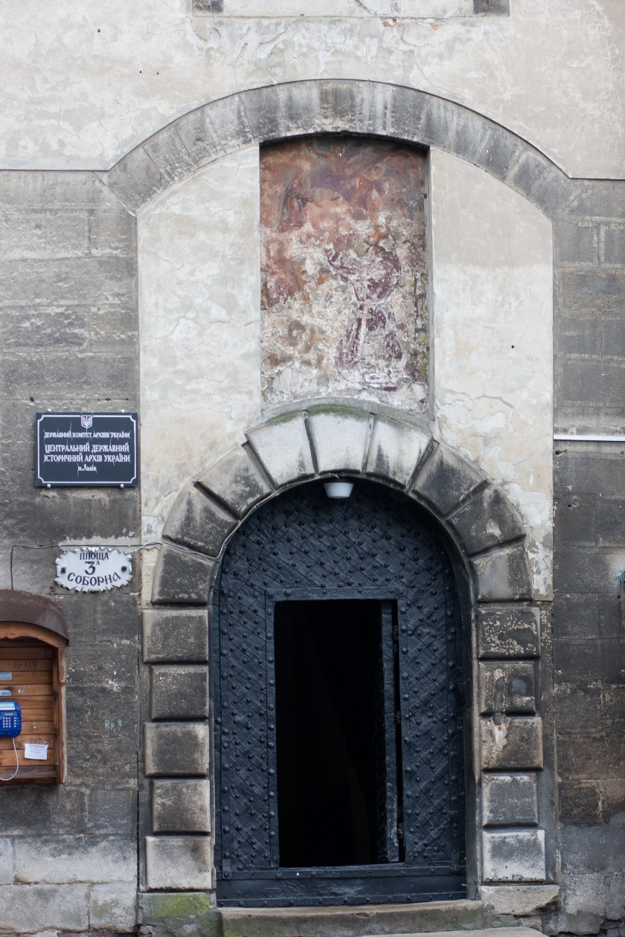
Lviv archive

Slide 15
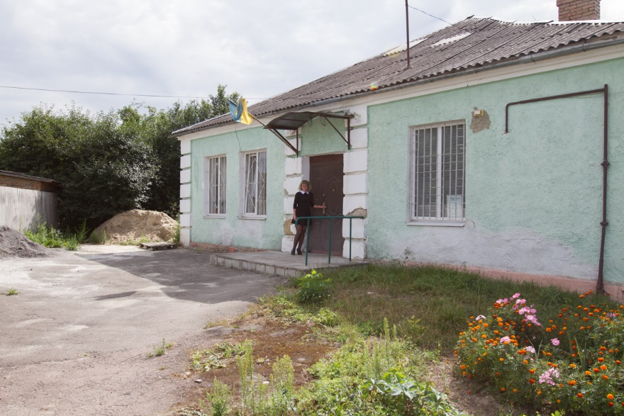
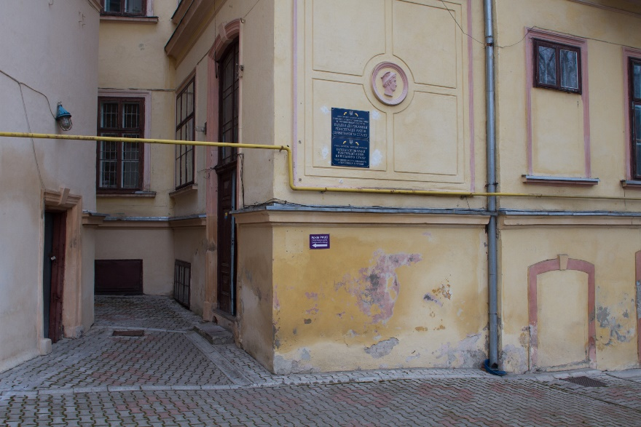
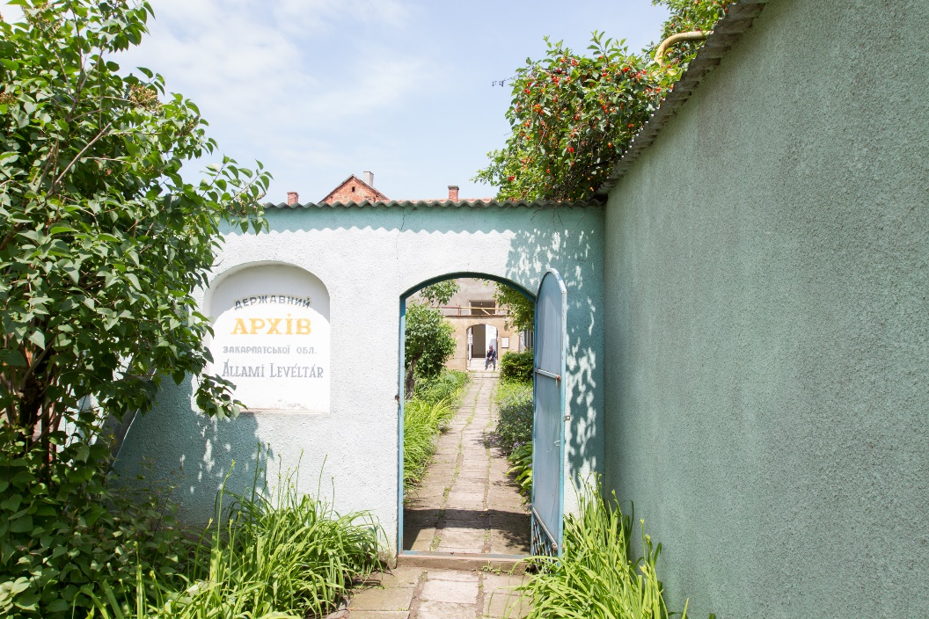
Zdolbuniv archive, Chernivci RAGS archive, Beregovo (Zakarpatya archive)

Slide 16
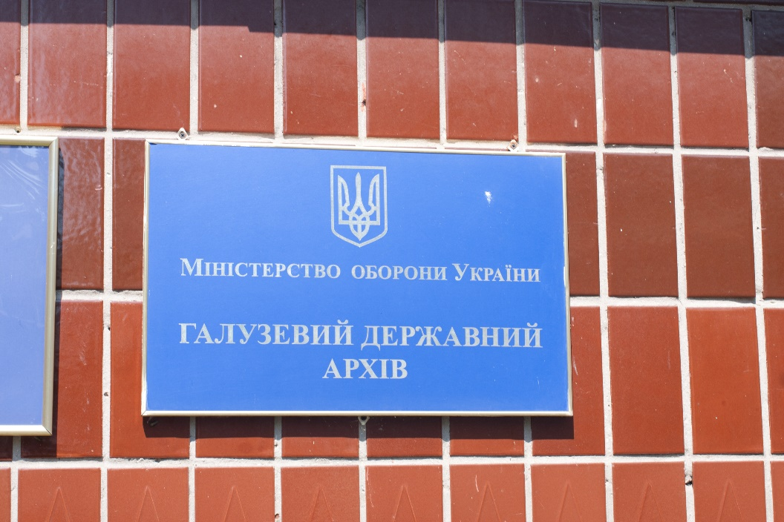
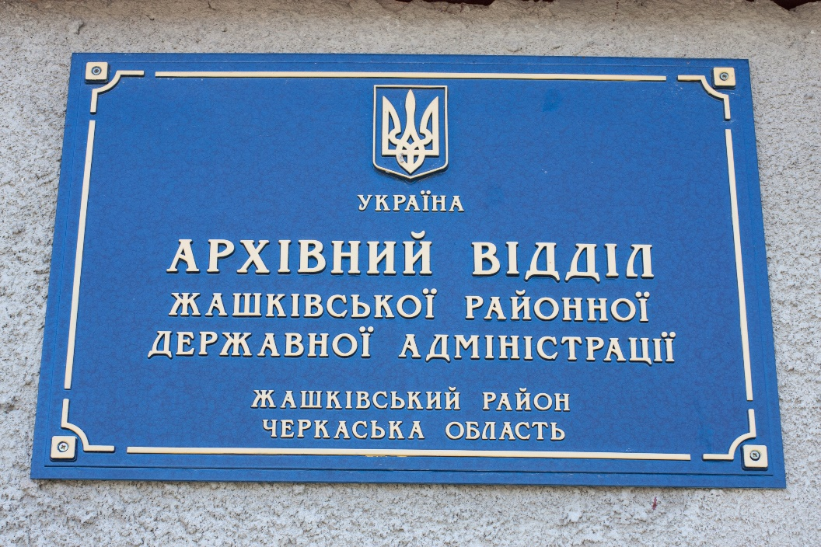
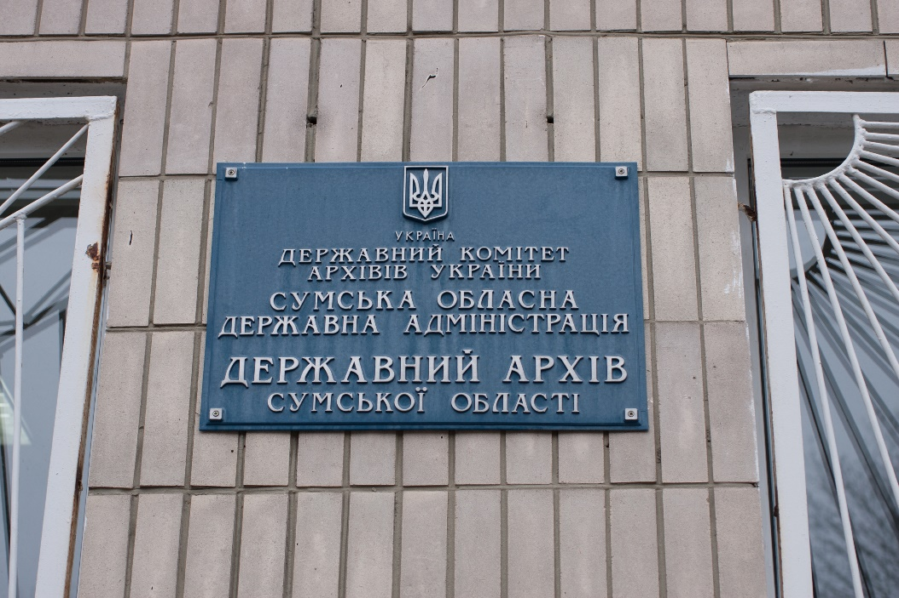
Archive plaques

Slide 17
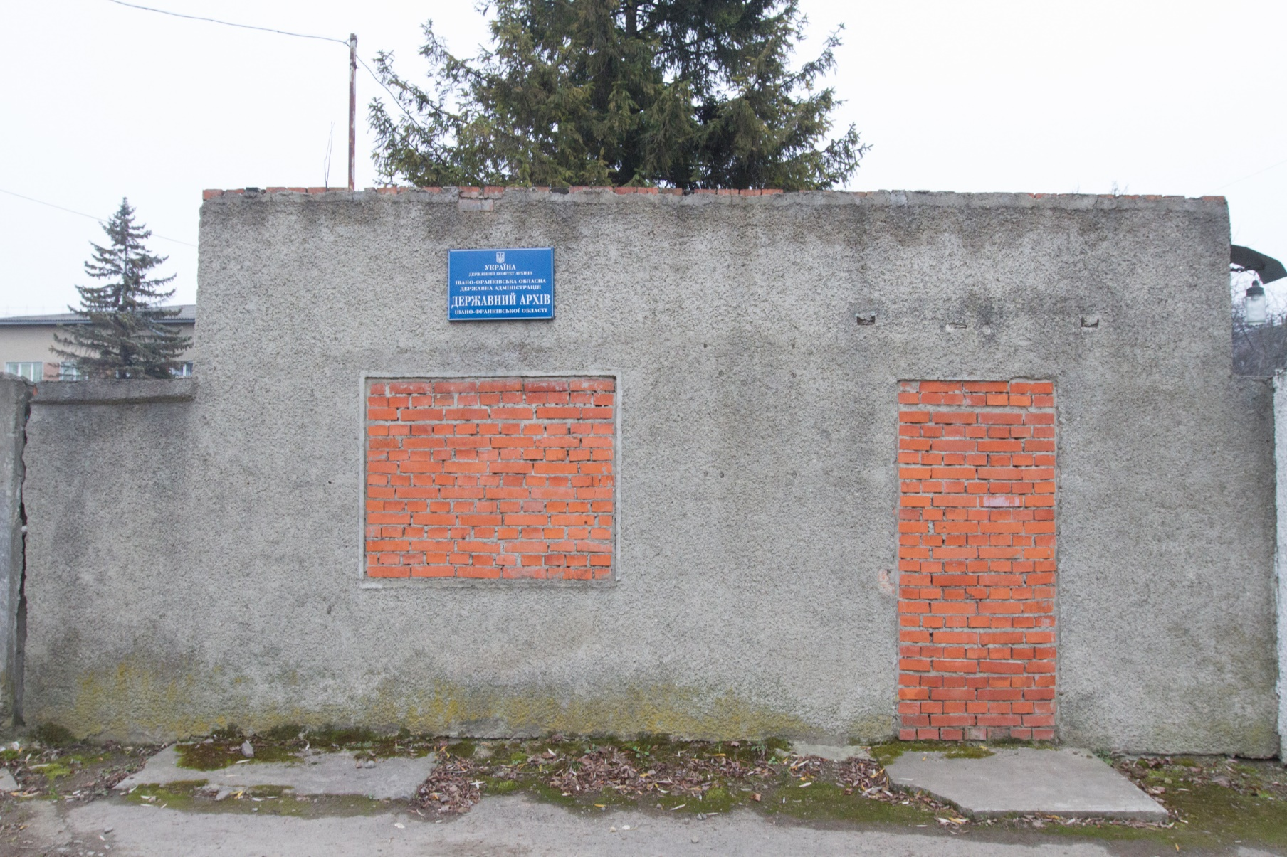
Ivano-Frankivsk archive

Slide 18
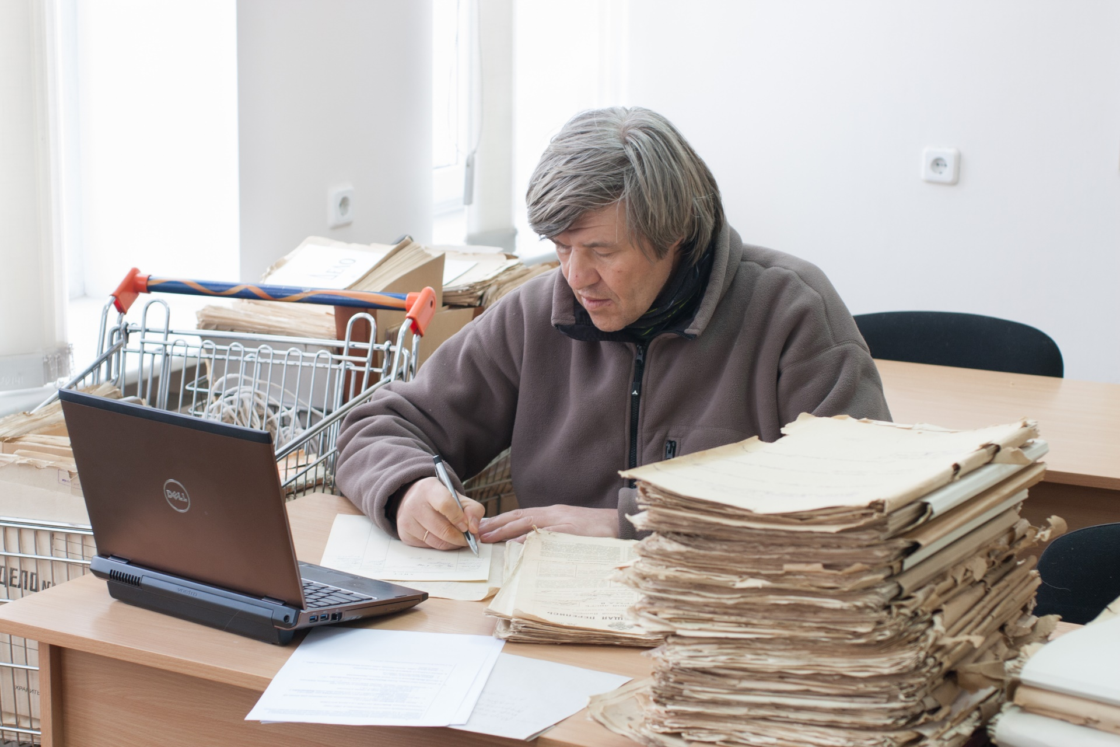
Inside archive

Slide 19
Write to archive
What they can and what they cannot.
Ukrainian/Russian OK. Polish might work in Lviv/Ternopil/Ivano-Frankivsk/Rivne. Romanian in Chernowcy, Hungarian in Zakarpatie. Writing in English lowers your chances.
Copy fee – expect the unexpected.
The only copy machine could be out of order for months.

Slide 20
Case study: Carpatian argentinians
Researched economic migration of Lemko people from selo Odrekhova, Syanotsky uezd, Prikarpatye.
Found that the village is very similar to the German colonies of 19th century;
And that the 18th-19th century records for this location are in Ukrainian language, but written in Latin script.
(Book published in 1970).

Slide 21
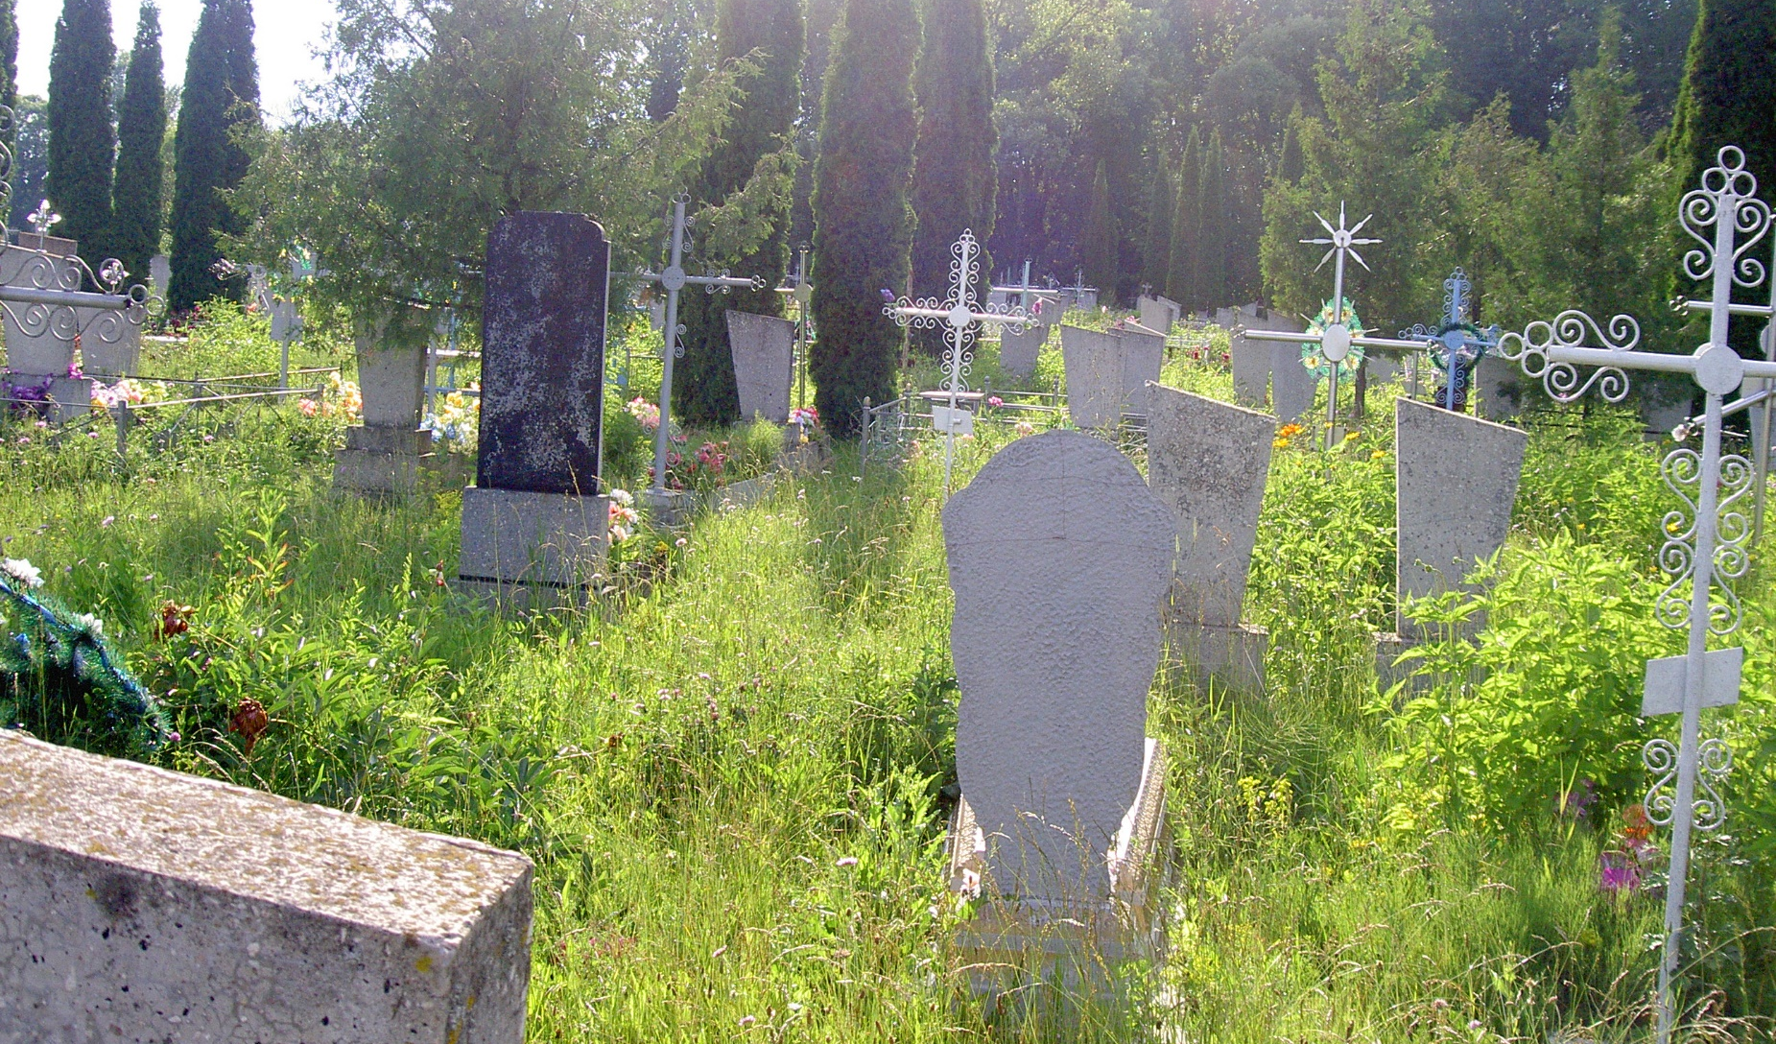
Got a negative answer
Do not worry, there still are other sources to check.

Slide 22
Other sources: pre 1917
Russian Empire territory:
  1897 census
  Revisions:
  IV 1781
  V 1794
  VI 1811
  VII 1815
  VIII 1833
  IX 1850
  X 1856 - generation gap here.
List of electors, lists of traders and other professions, nobility files, Department of Police card file.
Local directories.
Galicia – cadaster (land records, Pierwszy kataster gruntowy Galicji (tzw. metryka józefińska), Drugi kataster gruntowy Galicji (tzw. metryka franciszkańska).
Szlachta files – applications, rejected applications.
Hetmanschina - генеральная и полковые канцелярии + присяжные книги + реестры

Slide 23
Other sources: post1917
Court files (repressions)
State Security Service
Pensions office
Local (районные) archives
Newspapers
Phone books
Online databases
Ask local people – you can still find somebody who remembers details.
1920-1930 census in the Polish areas.
Obd-memoria.ru / podwignaroda.mil.ru
Ministry of interior (спецпереселенцы 1930х)
Ukrayinska Povstanska Armiya (UPA)

Slide 24
Web sources
archives.gov.ua
inn.rozshuk.com.ua
reabit.org.ua
Jewishgen.org
Rtr-foundation.org
Agad.pl
Vgd.ru
Book-old.ru
Rusgenproject.com
Obd-memorial.ru
Lists.memo.ru
Soldat.ru
Podwignaroda.mil.ru
Number.org

Slide 25
What we are missing here …
Germans – Lutheran records in St Petersbourg, EVZ records in College Park MD, Catholic records in Saratov, ITS (Bad Arolsen, Germany) odessa3.org grhs.org
Catholic and Jewish documents in Polish archives (always check AGAD if they have something)
Yad Vashem and other Jewish-specific sources.
Old believers, dukhobors…

Slide 26
Case study: Volkman
Client in his 40s, his parents in their 70s, nice family with no problems. Mother: „my mother never had any maiden name“.
Mother career: Kiev University Historical faculty, teacher of history, deputy director, director of school, 2nd secretary of raikom partii, retired.
Birth record (1919,Vinnitsa archive) indicates the godmother – Sofia Adamovna Folkman – matching rare fathers’ name.
Vinnitsa archive – Folkman repressions file (younger brother), does not list our subject.
SBU archive (Kiev)– another Folkman files (older brother), matching locations, lists our subject. Identity confirmed.
Father’s employment record (Kanash, Chuvashia, Russia, 1941) – confirms further details.
Further birth details (Lithuania state archive, Folkman’s births in Kovno (Kaunas) match SBU files.
Cherkassy state archive – party records of mother – some further hints.
Kiev University archive – Student’s personal file – further confirmations.

Slide 27
Case study: Volkman
GDASBU, delo 67093fp

Slide 28
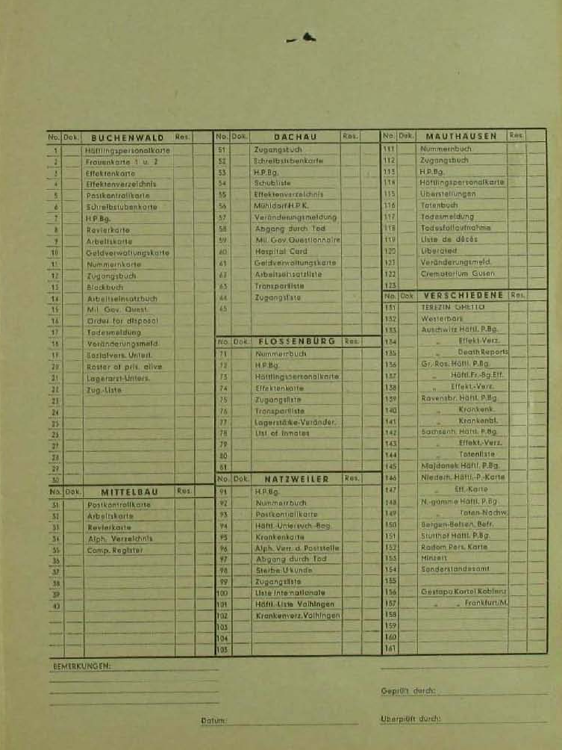
Case Study: Pchelin
Andreas Pchelin was born in 1900 in Stanislawow in Ukraine.
ITS Bad Arolsen: “Uspenka /Stanislavov”, his uncle “Ican Zajew”.
Nothing in Stanislavov (Ivano-Frankivsk).
The Uspenka is not found either as a name of location nearby or as a city part. No Uspenka in any archival research aids available on-site.
There was (and still is) Uspenka in Stalinskaya oblast (in 1940s), now Donetskaya/Luganskaya oblast (the place with the ongoing war).
The person probably gave the village name but replaced Sta-lino region with Sta-nislawow, just not to be sent home to Bolshewiks prison camps...

Slide 29
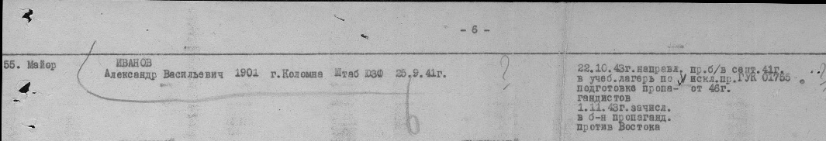
Case study: Ivanov
Alexander Vasilievich Ivanov, *1901, former Soviet officer. Place of birth – “Colomoa”.
Kolomya? All records carefully checked. Nothing.
“Yes, yes, dedushka sometimes said the place was called Colomon”…
Kolomna, Moscow region. Obd-memorial.ru

Slide 30
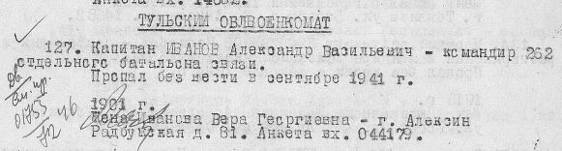
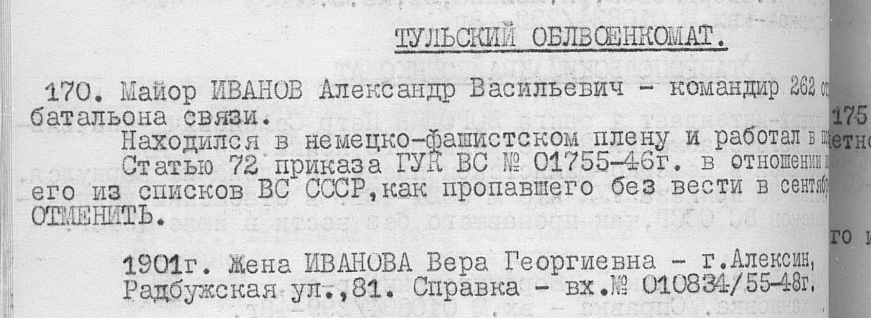
Case study: Ivanov
Central Archive of Ministry of Defense, Podolsk, Russia – officer case file found. Wife and child listed.
The identity was used 3 times to send spies during the war.
Then we found the “last known residence address” – in Aleksin, Tula region. We went there and found relatives still living there.
And they remembered that the orphan was sent to Tula to live with aunt, who worked in the psychiatry hospital.
Then we hit the brick wall. Nothing nowhere. Trail breaks in 1980s, and there’s no way to find Ivanov’s daughter…

Slide 31
Case study: Rich Jewish horse breeder
Babushka died aged 106, in Kirovograd region. She was born in Kuban, in the rich Jewish horse breeder family, who managed the horse farm until 1918 and then father with her brothers went to Palestine.
Father wanted her to marry old rich Jew, she ran away with worker of the horse farm to Bessarabia.
Then they moved to Odessa, where she was a servant of the Odessa seminary head.
Son of the head was assigned to work in church in Kirovograd region and she moved with him there.
Client wanted us to go to Krasnodar, Eisk to locate this “Jewish horse breeder”.
But we first went to Kirovograd archive.
Found: babushka’s husband (“priest”) lived in the same Kirovograd village (listed as a godfather many times).
Older children, while born somewhere else, died there in 1903.
Seven other Babushka’s children were all born in this Kirovograd village during 1901-1915.
Do you love to read female romantic romans of early 1900s?

Slide 32
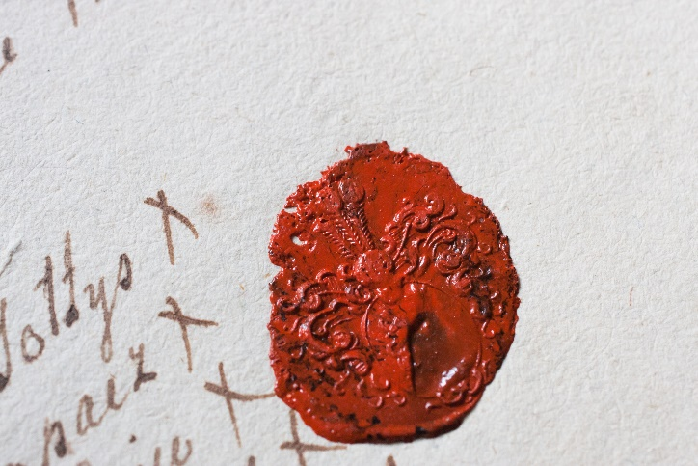
Thank you for your attention
Please do not hesitate to contact
www.rusgenproject.com
(646) 873-6773
info@rusgenproject.com
Kirill Chashchin
Olexa Baliura
Konstantin Kuranov
Victoria Sharonova

